Slide 1
http://arnaud-nauwynck.github.io
arnaud.nauwynck@gmail.com
Big Data
History, Hardware-Software evolution
To
Distributed Computing

Slide 2

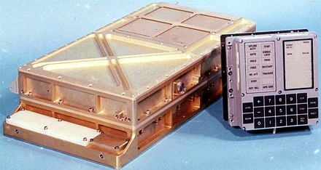
Big Data ...
Big? is Time-relative
cell phone (in 2021) >= 1000x "more"
than Appolo moon
guidance computer (1968)

Slide 3
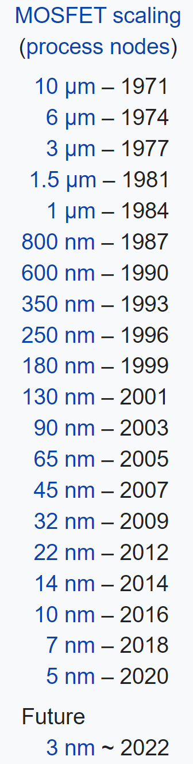
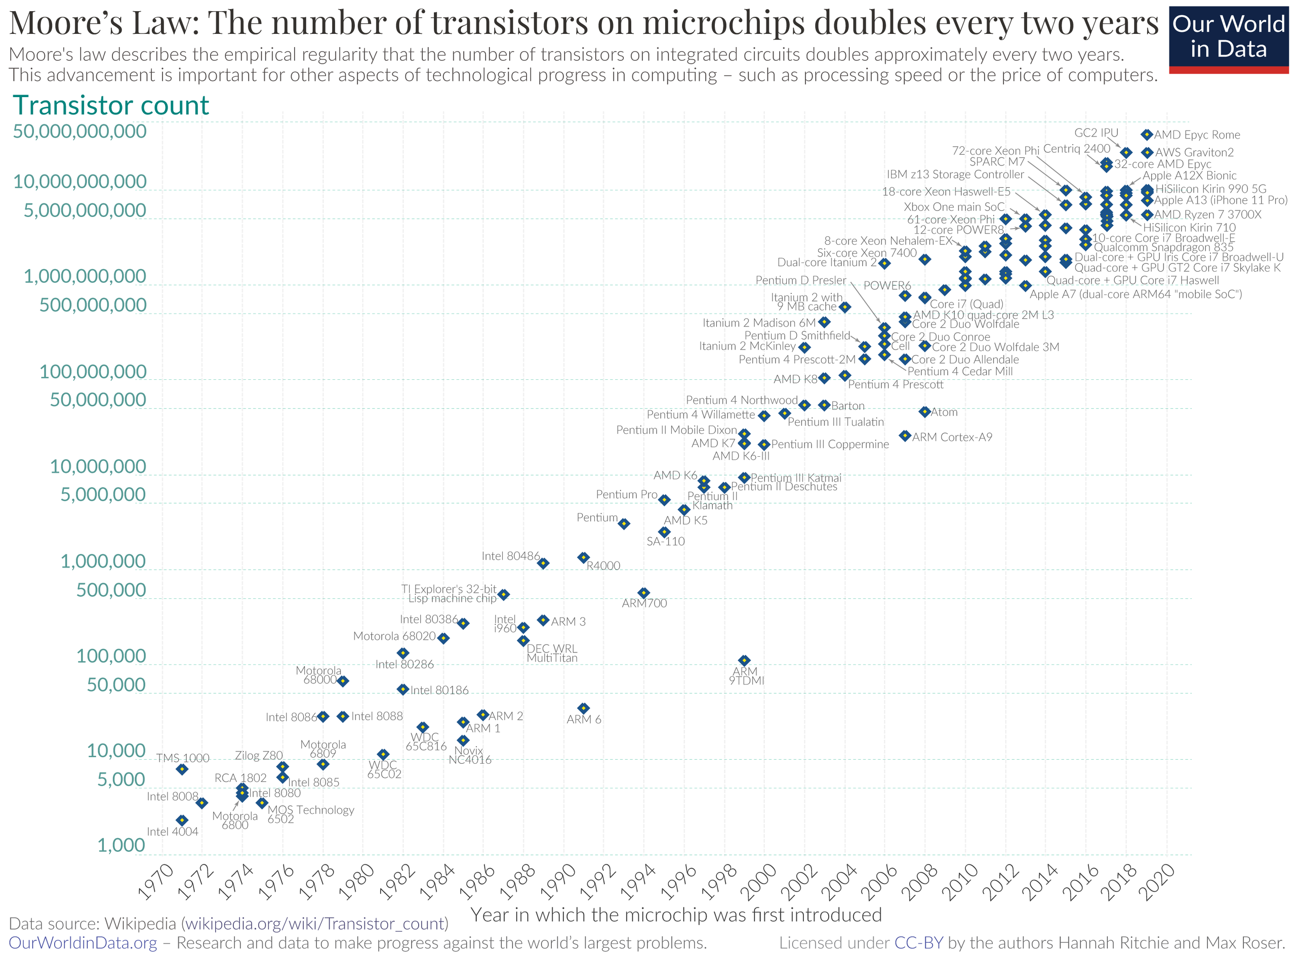
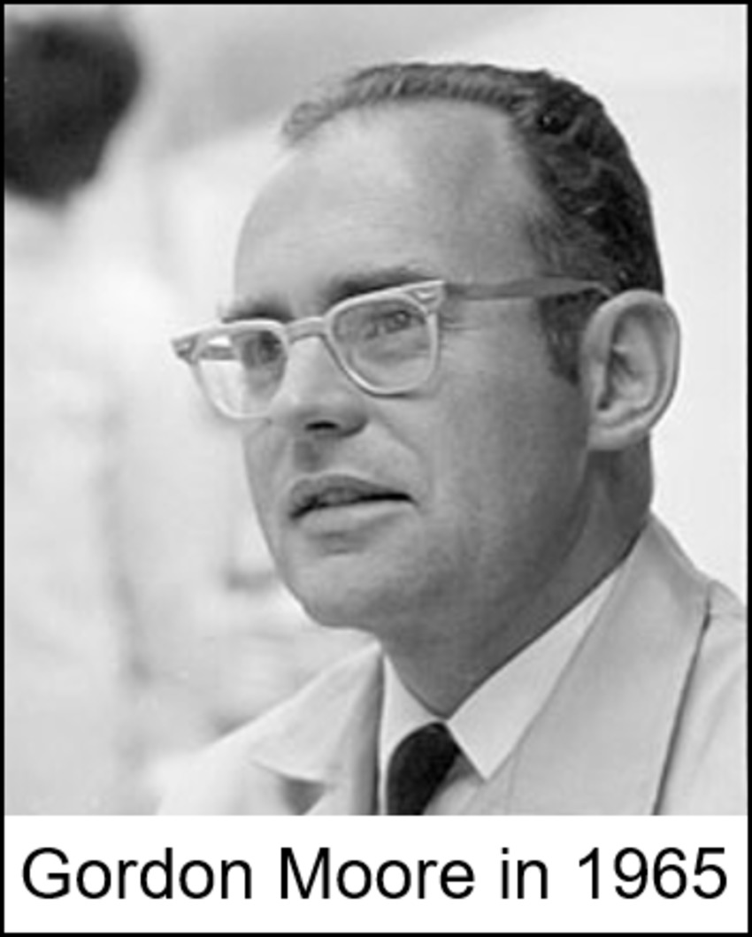
Moore’s Laws

Slide 4
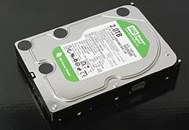
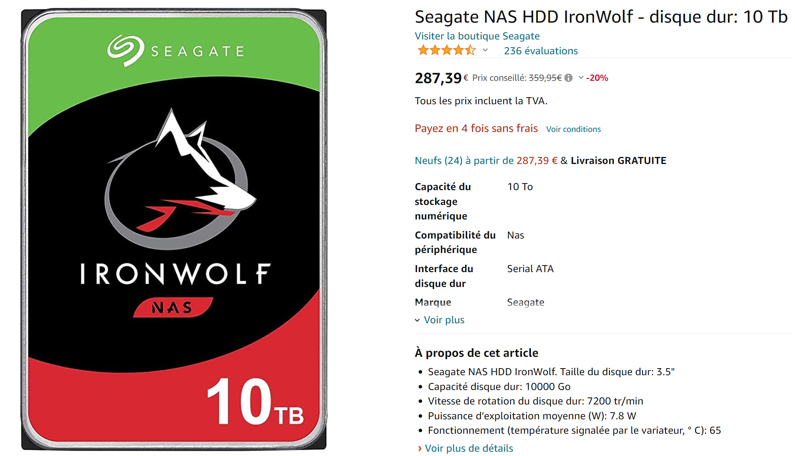
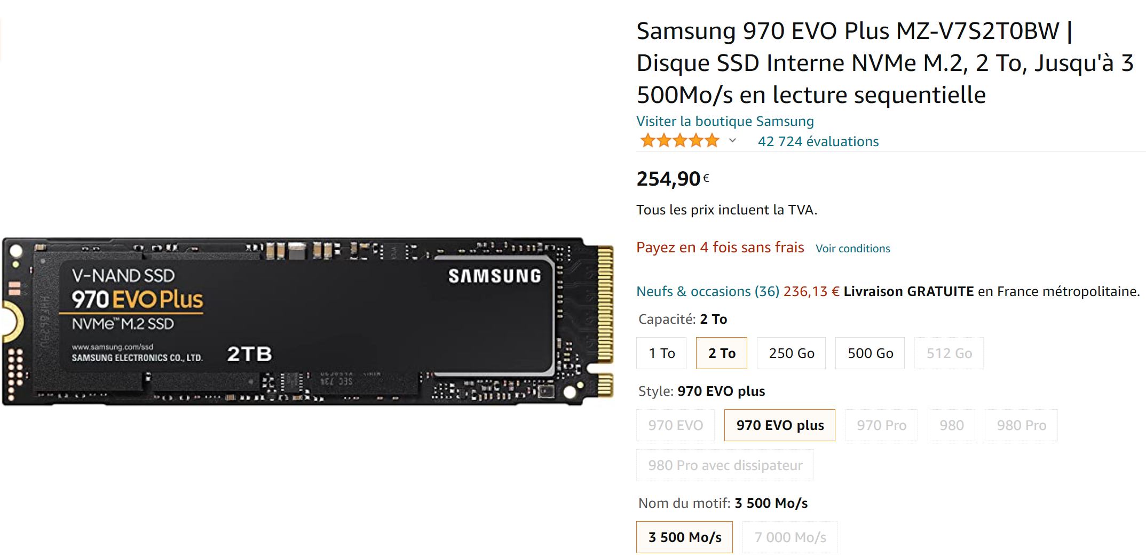
Kryder’s « Law »
density & capability of hard drive storage ~ *2 every 13 months
HDD: 2To in 2011
HDD: 10To in 2021 (~300 euros)
SSD: 2To in 2021 (~250 euros)

Slide 5
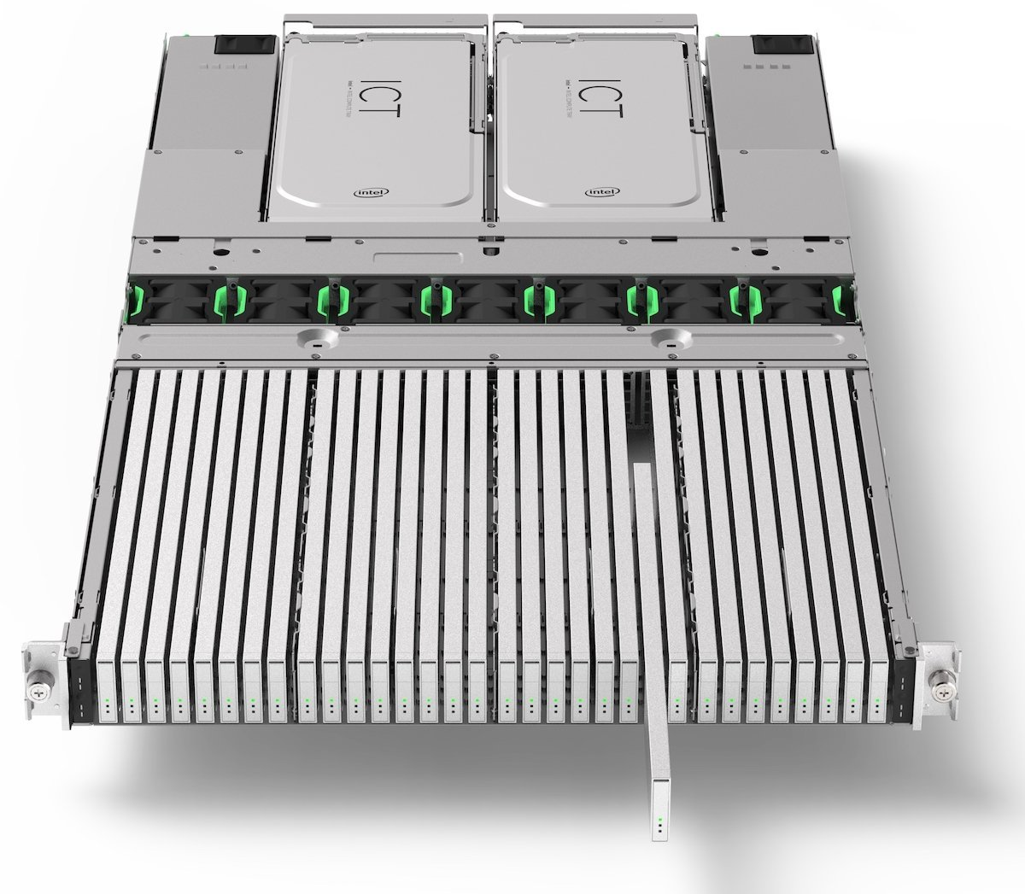
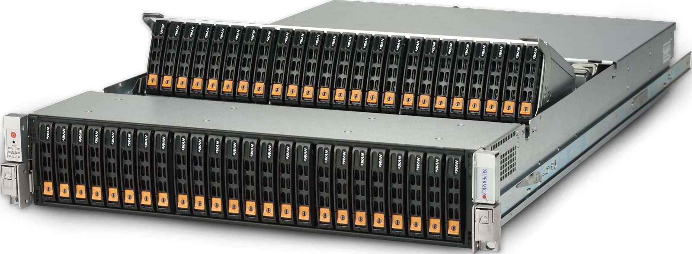
Density…
48 * HDD disks in 2U blade
32 * SSD (E.1 EDSFF) in 1U blade
… 500 Tera / 1 Peta !! … 200 000 euros

Slide 6
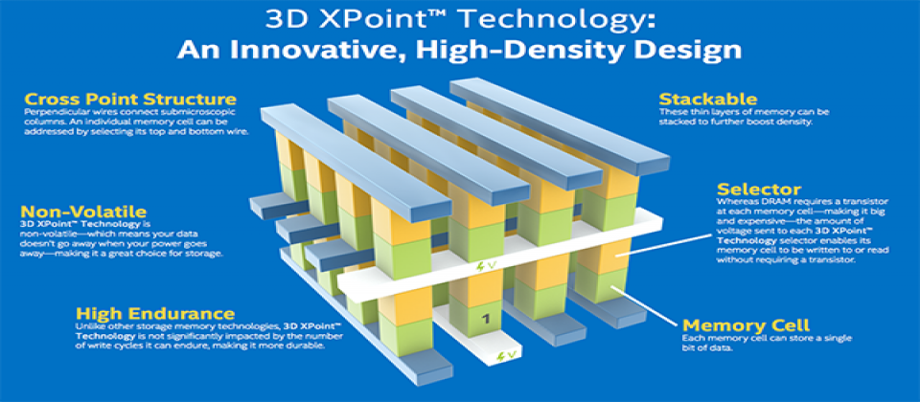
SCM: Storage Class Memory
persistent + fast
Compromise NDRAM <-> SSD

Slide 7
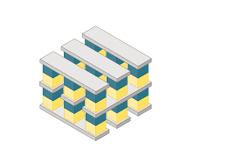
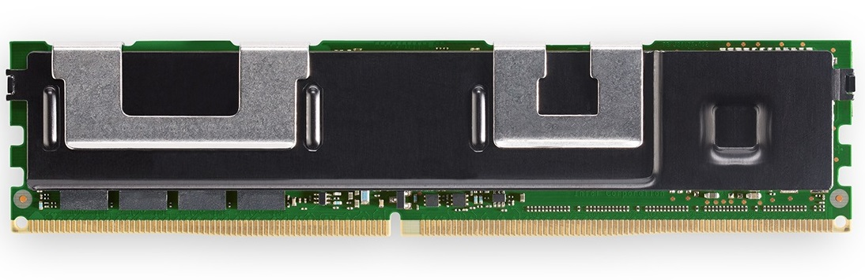
3D - Intel Optane
No transistors … changed of state (resistance)
in 3D stacks
10x faster (*more expensive) than SSD
Slower (cheaper) than DDR4 RAM
For server up to 3To fast & persistent memory…
~ 12 000 $ / 1 To

Slide 8
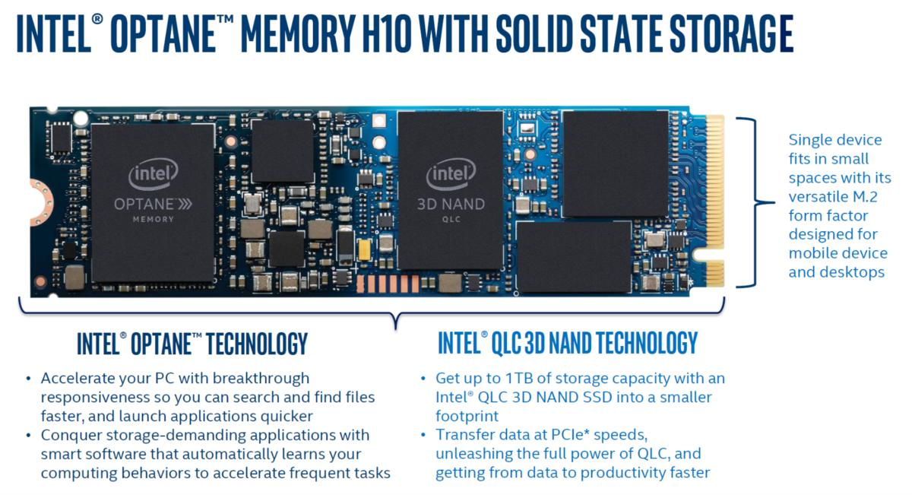
NAND (SSD) + Optane as Cache

Slide 9
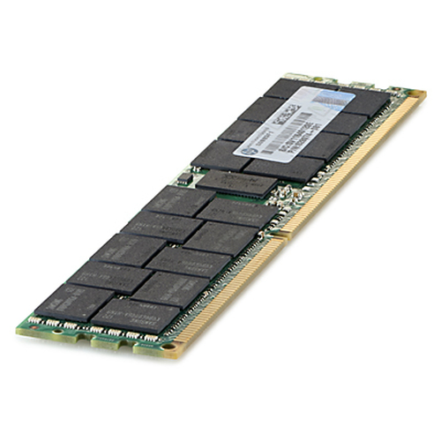
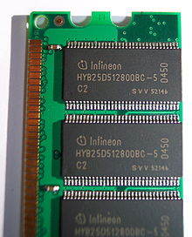
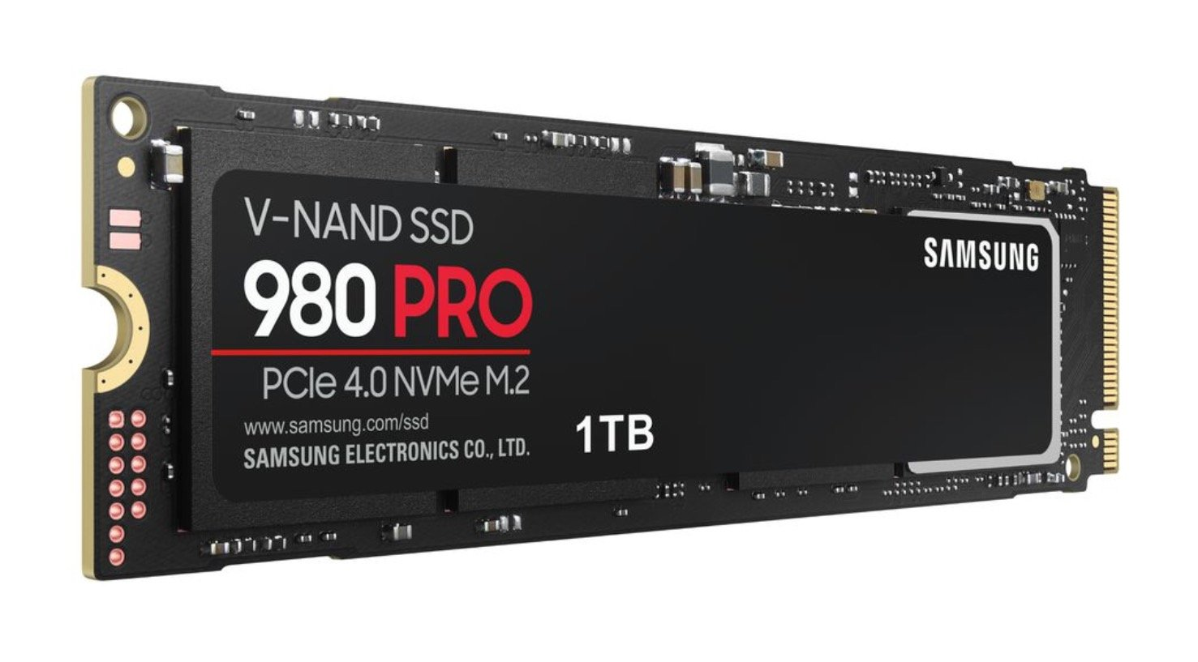
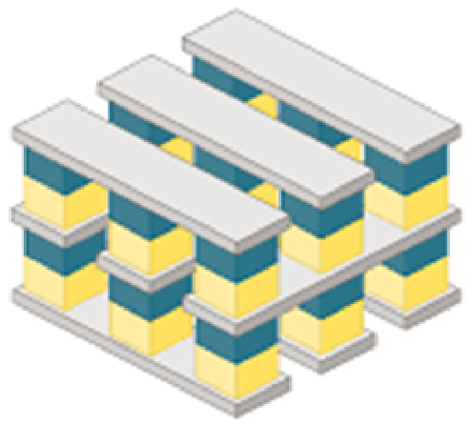
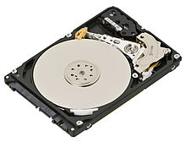
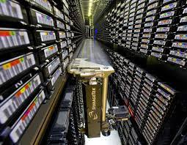
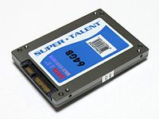
Memory & Disk Technologies Disruptions
future
switch??
RAM
~2015
Switch HDD / SSD
HDD
Tape
SSD (since 1991)
SCM - 3D Xpoint
(since 2017)
Next switch ??
> 2022

Slide 10
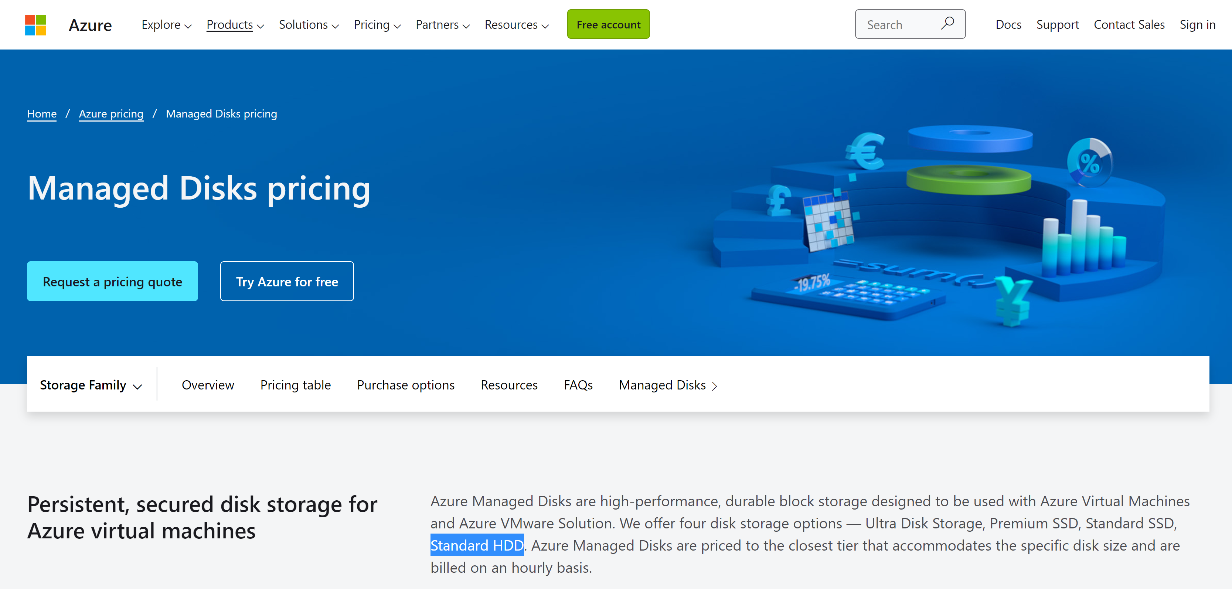
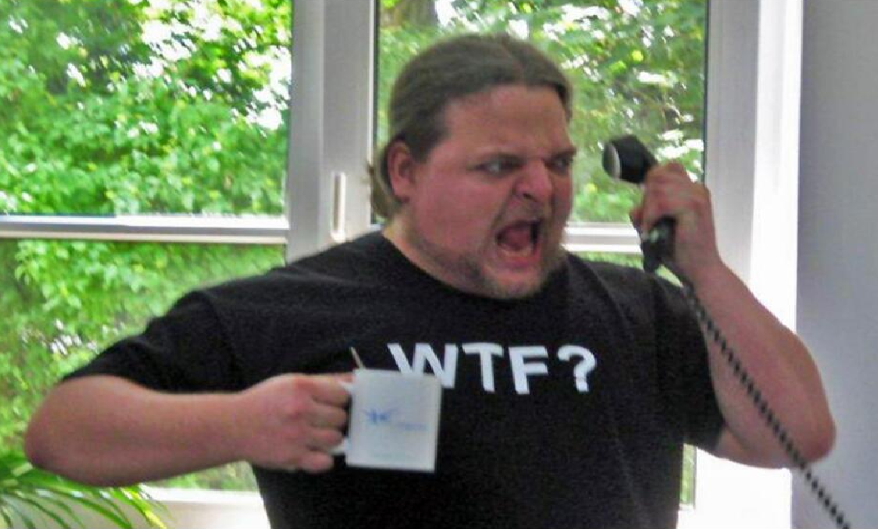
Example HDD -> SSD
???
No more HDD Hardwares in Azure DataCenters !!!!
HDD are emulated « throttled »
From SSD
For lower perf … lower billed

Slide 11
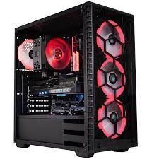
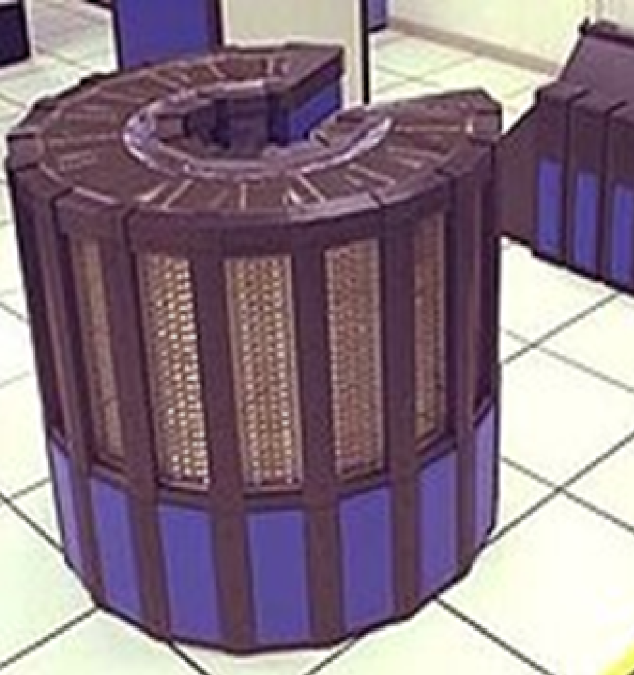
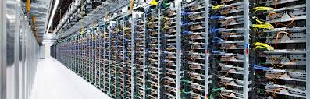
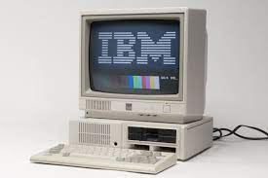
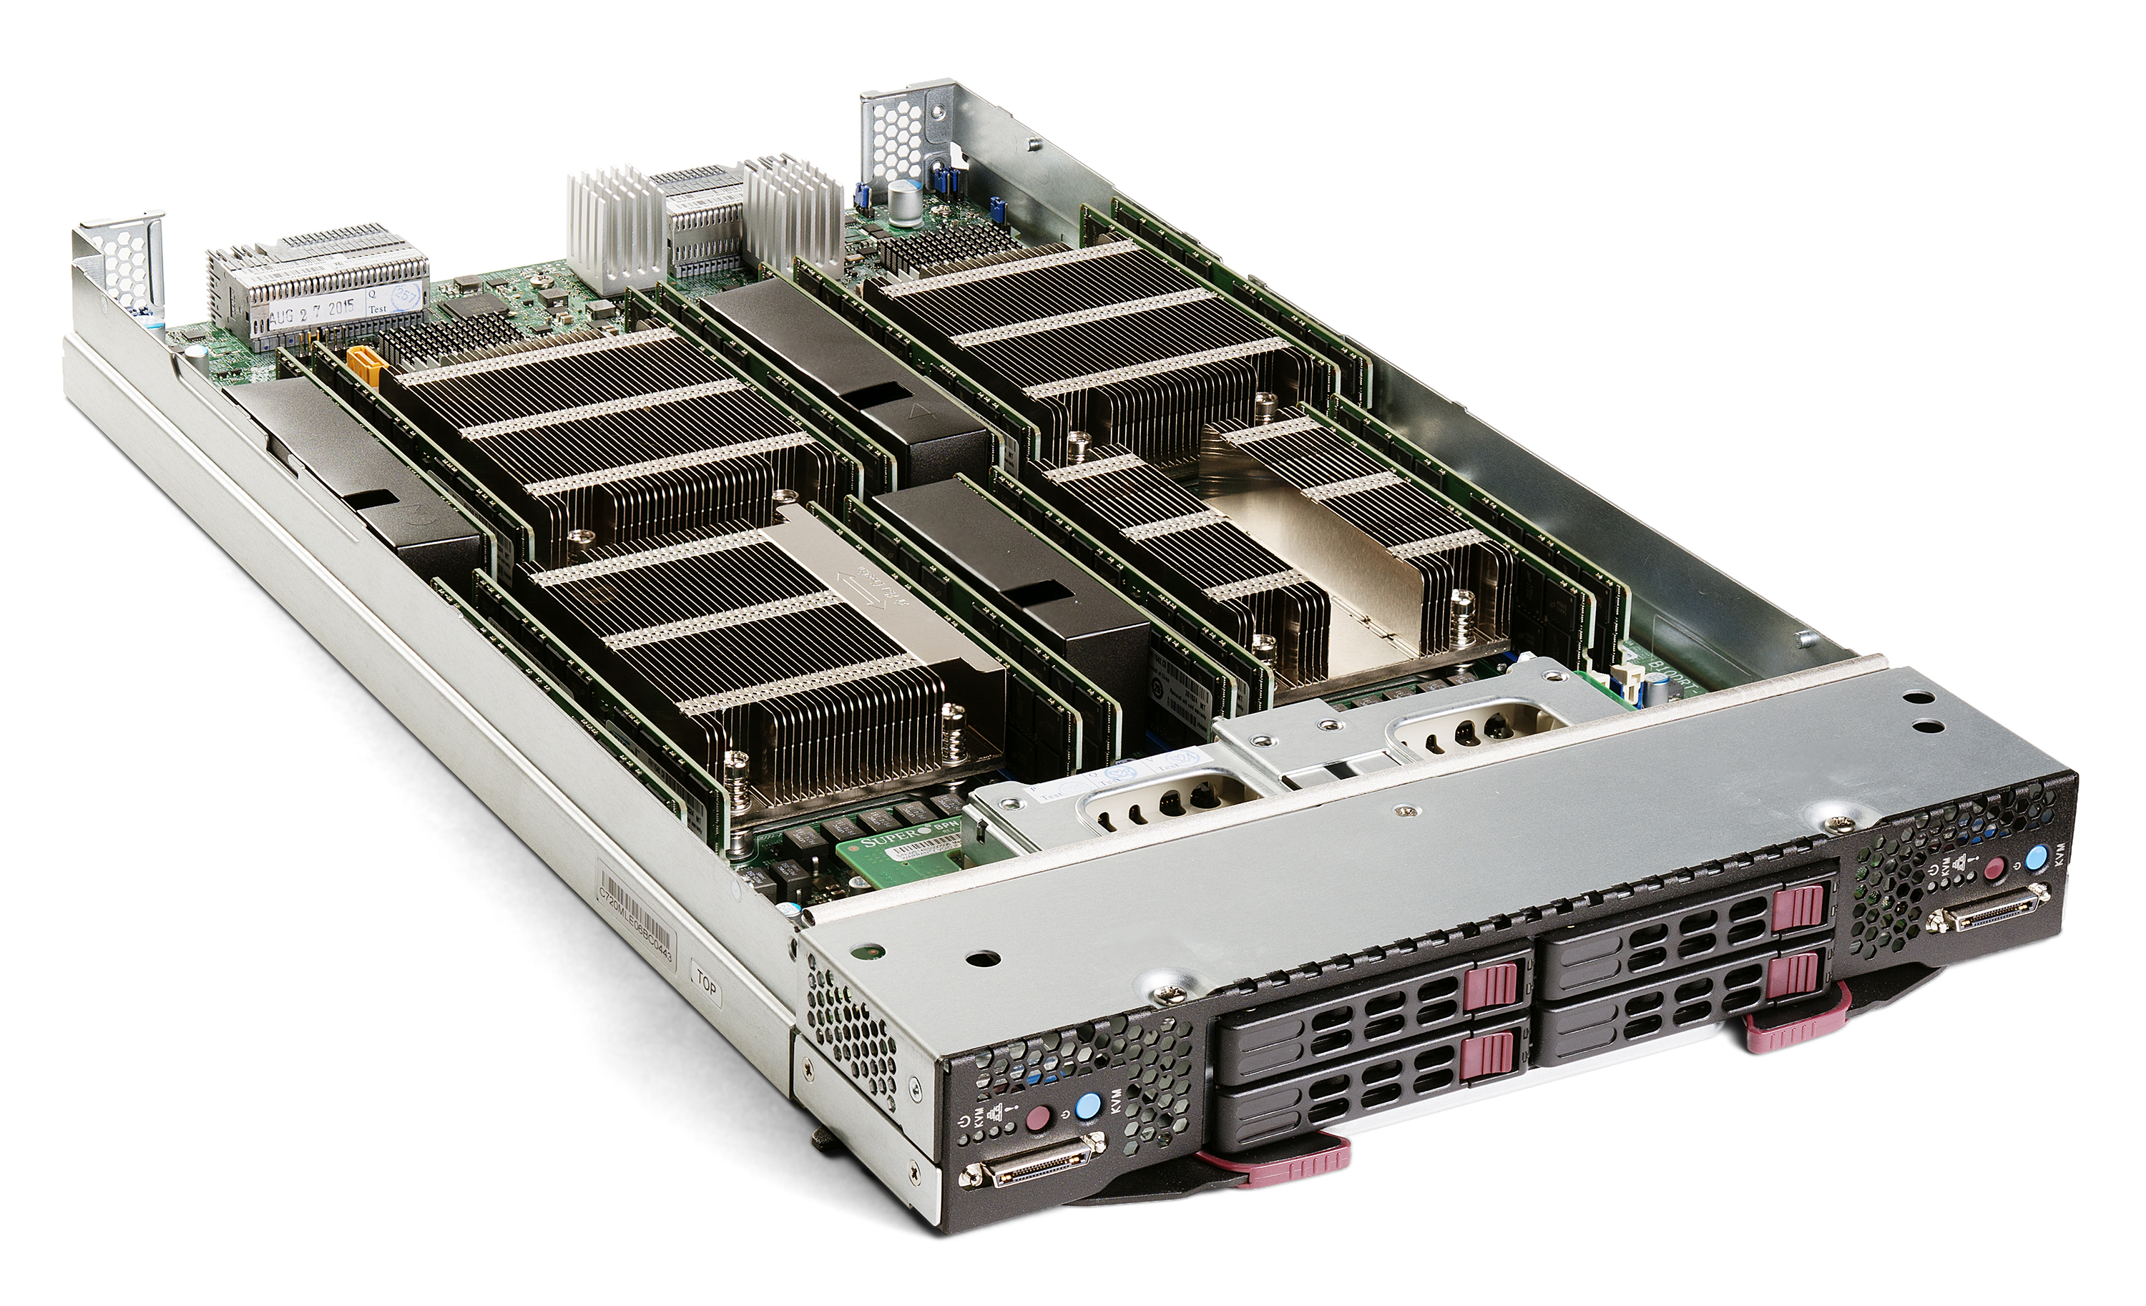
Vertical -> Horyzontal Scaling
Disruptions of DataCenters
Hardwares:
Distributed (DataCenters)
Hardwares:
Super-Computer
« Crays »
1980 : PC
« Blade » commodity hardwares

Slide 12
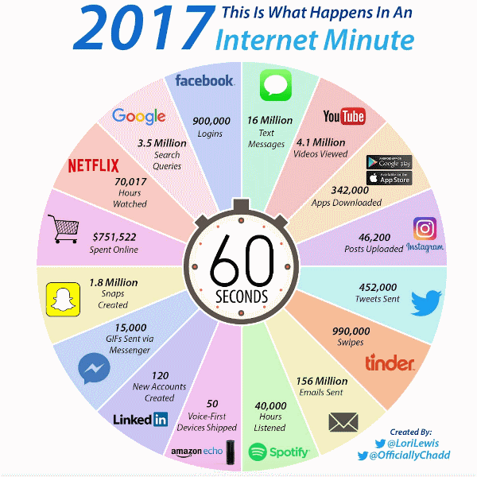
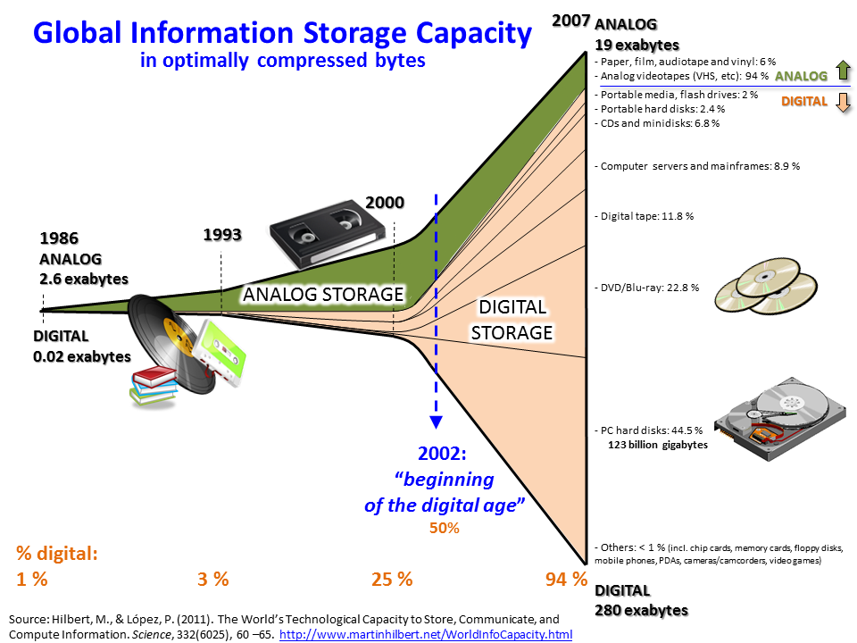
Data,Data,Data = DataCenters

Slide 13
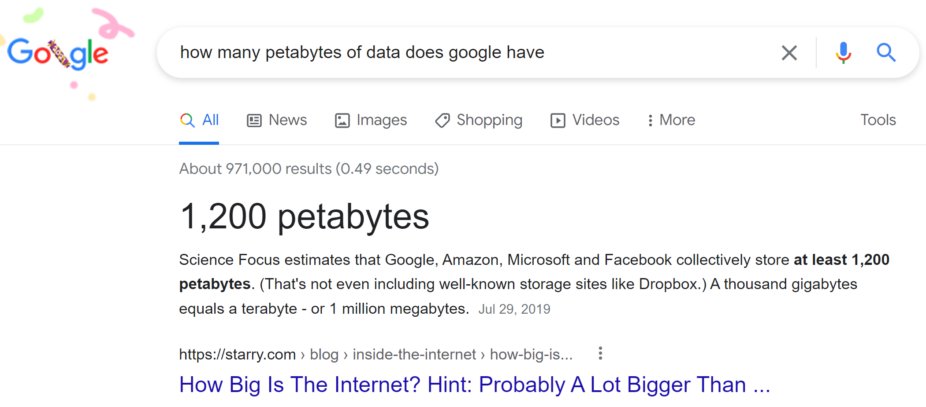

Slide 14
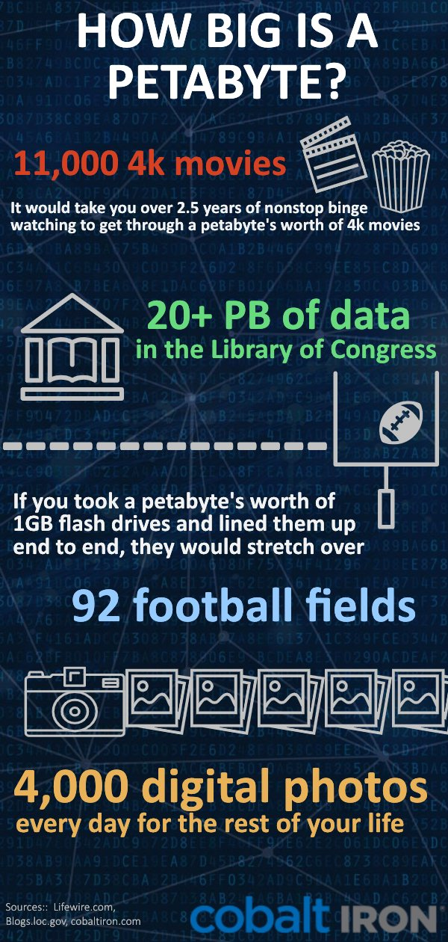

1 Peta = 1000 Teras
= 1,125,899,906,842,624 Bytes
Not Only for
Example at French Bank «SG » : 3 Petas in 2020
for storing Vars / Risks / market params / trades
« Small » Cluster : 6 racks
~ 90 servers * { 256 RAM + 42 cores + 8 disks }

Slide 15
Softwares for BigData ?
No more traditionnal
Oracle DB + single Jdbc client …

Slide 16
Definition of BigData
= NO FIT in a Single Server (even 10Million$, Huge with SAN)

Slide 17
3 Vs
Volume, Velocity, Variety
(5vs : + veracity, value )

Slide 18
3 Vs
Volume, Velocity, Variety
> Peta bytes
<= 1 h / day to process
>= Millions files
( Parquet..)

Slide 19
Softwares Disruption
Distributed & Fault Tolerance
Software: MPI
Message
Passing
Interface
(1 OS, 1 process, N Threads)
Software: MapReduce
Distributed computing
… Fault Tolerant
1995
2004

Slide 20
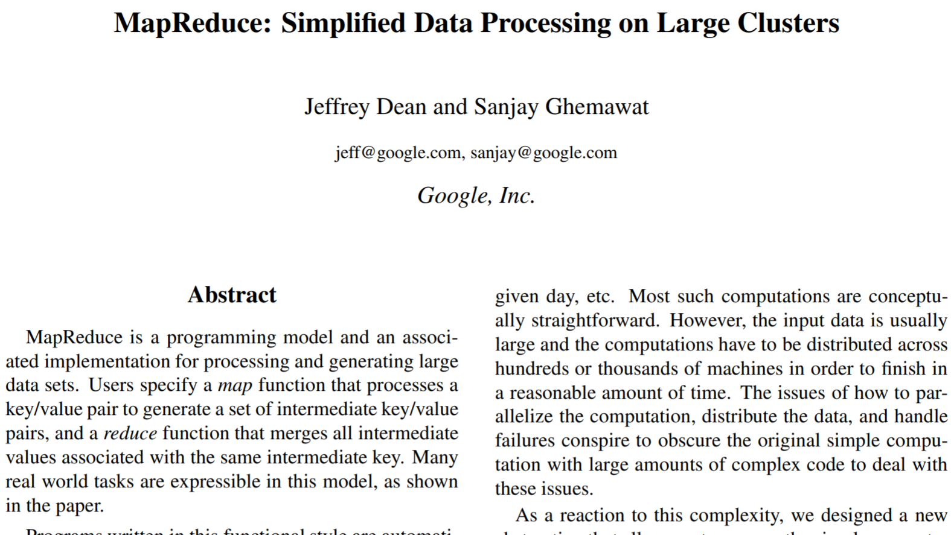
MapReduce Google paper : 2004
(end of use ~2014)

Slide 21

MapReduce @Yahoo = Hadoop .. 2006
Commodity Hardwares (datacenters):
Only HDD + RAM
Data Locality : co-host Storage near Compute
use RAM to cache
avoid network
Constraint
=>
Architecture
Choice
Think different?
2006
2020

Slide 22
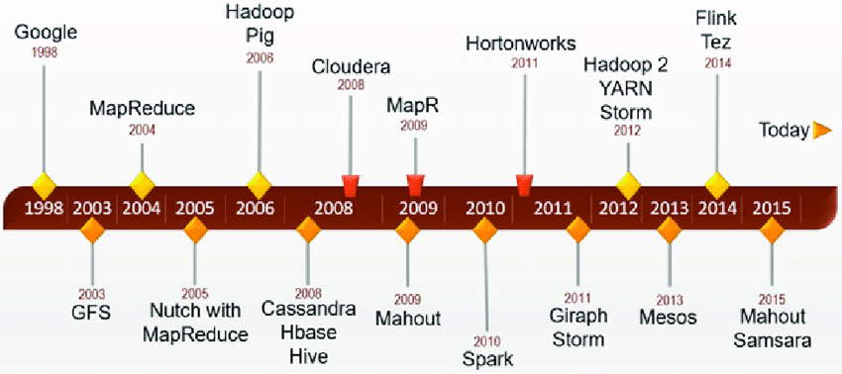
Hadoop + Community + Companies
+ Specific Tool 1 + Specific Tool 2+ …

Slide 23
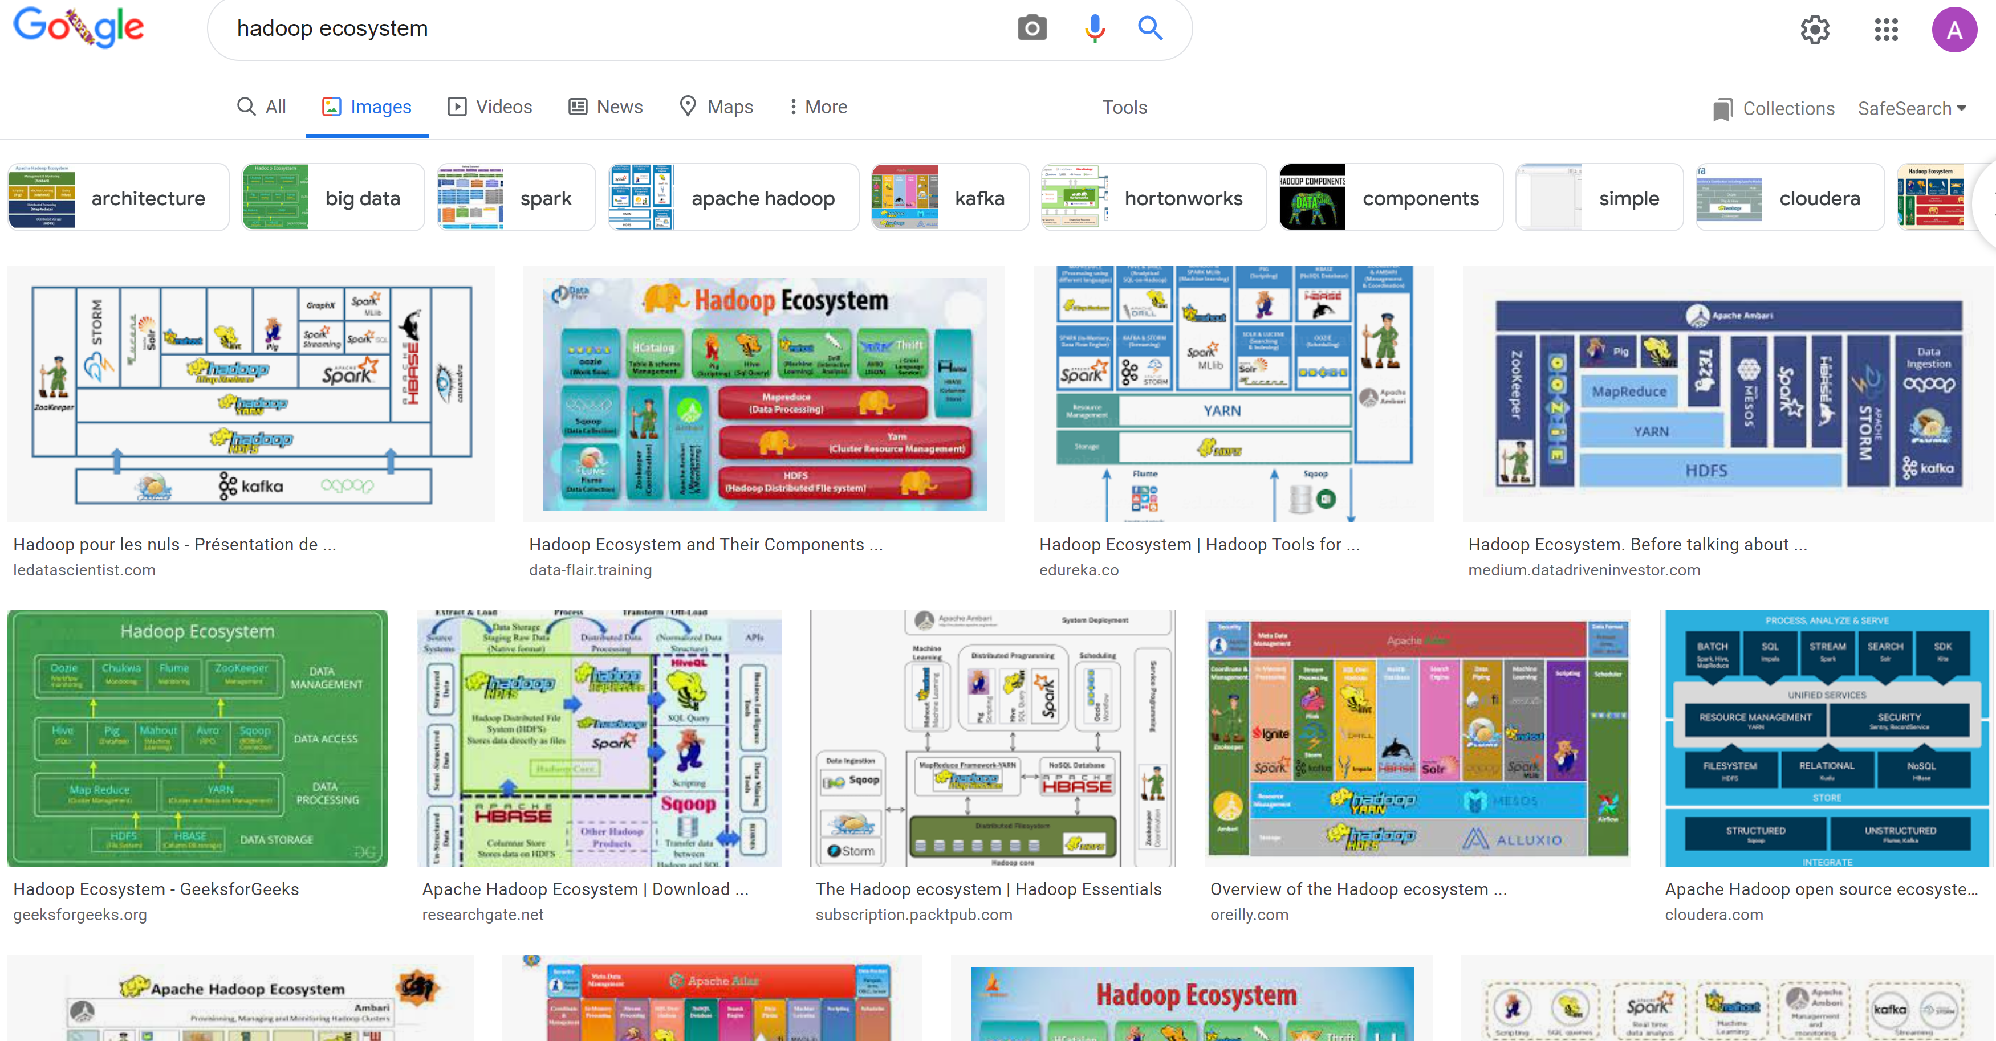
Hadoop Ecosystem « Explosion »

Slide 24

At The end, Only 1 will remain
( French TV Game: Koh-Lanta)

Slide 25


Slide 26
Spark Spark Sql / Mlib / .. Spark Streaming
1 System
N library extensions
2 Modes (Batch / Streaming)

Slide 27
